Slide 1
CodeForge Compiler
Muhammad Fahad 37125
Mehboob Waqar 37134

Slide 2
Language & Compiler Overview
Language Name: CodeForge
Compiler Name: CodeForgeCompiler
Goals:
Pedagogical clarity
Clean syntax inspired by C/C++/Java
Easy mapping to three-address code & assembly

Slide 3
Core Data Types
Type | Keyword | Description | Example
Integer | nmb | Whole numbers | nmb age =. 21;
Float | flat | Floating-point | flat pi =. 3.14;
String | Sring | Double-quoted text | Sring name =. "Ali";
Boolean | buul | true / false | buul ok =. true;
Char | cter | Single-quoted character | cter c =. 'A';

Slide 4
Keywords
Category | Keywords
Conditional Statements | oye (if), chaloye (else-if), naioye (else)
Loops | first (for), wish (while), last … wish (do-while), brk (break)
Functions | Ex (declare), rat (return)
Input / Output | enter (read), printO (write)

Slide 5
Operators
Operator | Symbol | Description
Addition | +. | Adds two values
Subtraction | -. | Subtracts two values
Multiplication | *. | Multiplies two values
Division | /. | Divides two values
Modulus | %. | Finds the remainder
Assignment | =. | Assigns a value
Equal to | ==. | Checks if two values are equal
Not equal | !=. | Checks if two values are not equal
Greater than | >. | Checks if left is greater than right
Less than | <. | Checks if left is smaller than right
Greater or equal | >=. | Checks if left is greater than or equal to right
Less or equal | <=. | Checks if left is smaller or equal to right
Logical AND | &&. | Both conditions must be true
Logical OR | ||.
Logical NOT | !. | Reverses a condition

Slide 6
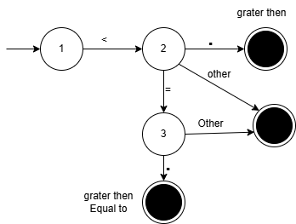
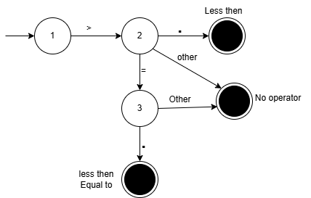
Transition Diagrams:
GraterThen or equal
LessThen or equql

Slide 7
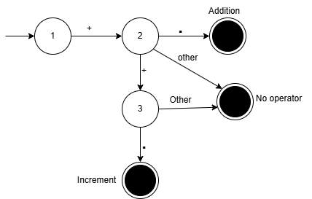
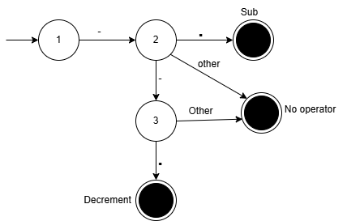
Transition Diagrams:
Addition & Increment
Subtraction & Decrement

Slide 8
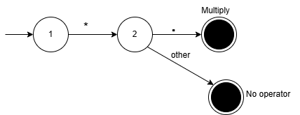
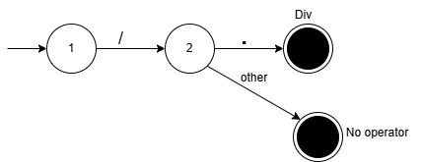
Transition Diagrams:
Multiply
Divide

Slide 9
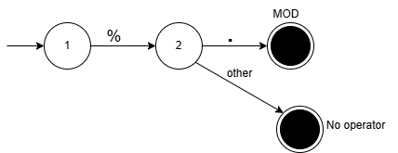

Transition Diagrams:
MOD
Not or Not equal

Slide 10
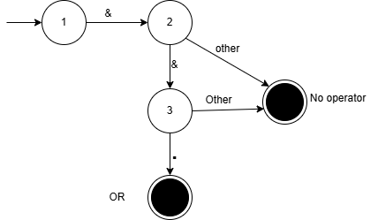

Transition Diagrams:
And
OR

Slide 11
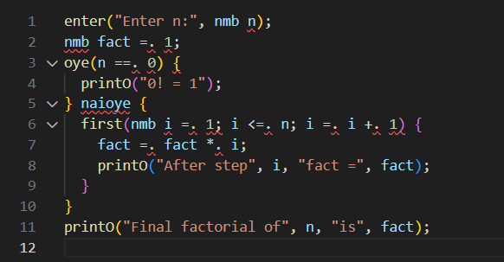
Program

Slide 12
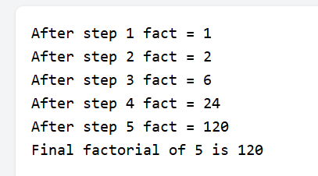
output

Slide 13
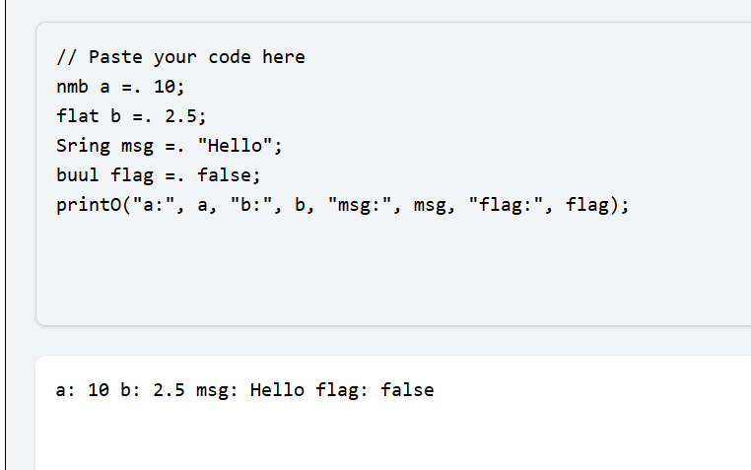

Slide 14
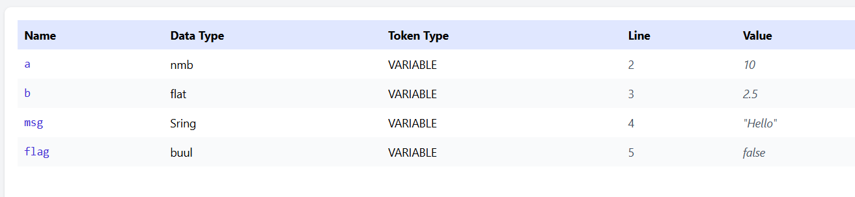
Symbol Table

Slide 15
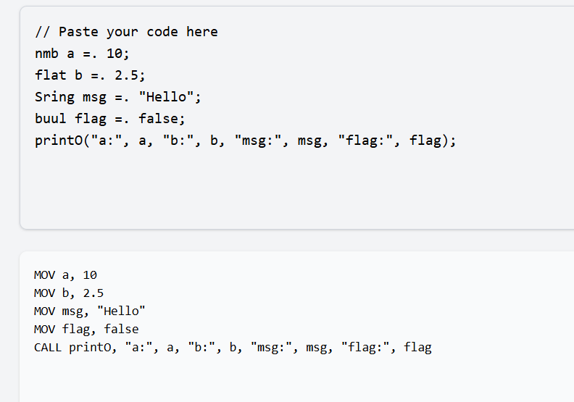
Assemly Code

Slide 16
Thank YOu

